Slide 1
ORB Features

Slide 2
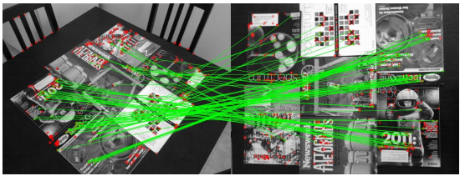
ORB Features
ORB is another feature detector, also implemented in OpenCV
It’s not patented! So it is in the latest version of OpenCV
Another benefit – ORB is really fast, and works almost as well as SIFT/SURF
ORB stands for “Oriented FAST and Rotated Brief”
It combines the FAST keypoint detector and the BRIEF descriptor
Rublee, Ethan, et al. "ORB: An efficient alternative to SIFT or SURF." ICCV. Vol. 11. No. 1. 2011.
http://citeseerx.ist.psu.edu/viewdoc/download?doi=10.1.1.370.4395&rep=rep1&type=pdf

Slide 3
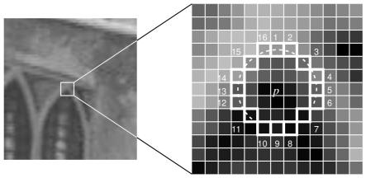
FAST interest point detector
For each pixel p:
Consider circle of pixels around p
p is a keypoint if there are at least n contiguous pixels in this circle that are all brighter or all darker than p by some pre-set threshold t
Before checking all 16 pixels in the circle, just consider the 4 cardinal pixels: if at least 3 of them aren’t all lighter or all darker, just move on.

Slide 4
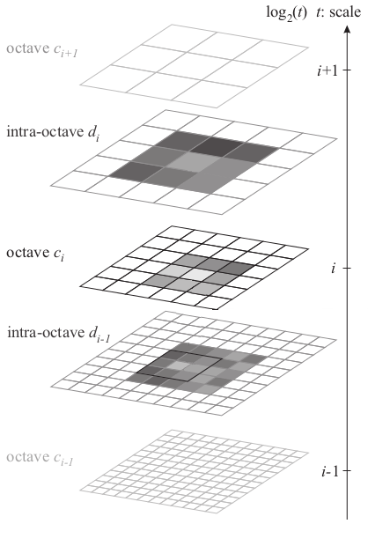
FAST interest point detector
A pyramid of images is used to find scale
Keypoints are local maxima in the image, and across scales
Additional processing:
Reject points in texture-less regions, or points along edges (they can’t be localized well)
Estimate orientation from intensity centroid

Slide 5
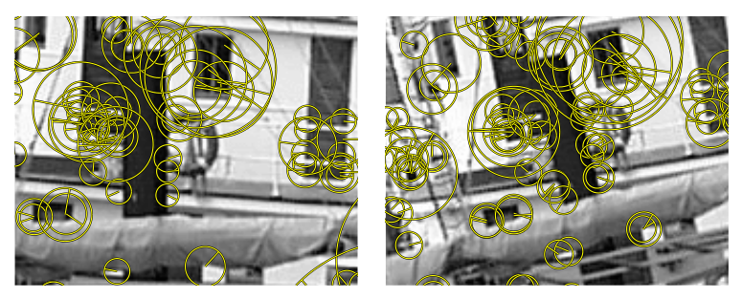
Keypoint attributes
Similar to SIFT and SURF, keypoints have location, scale and orientation

Slide 6
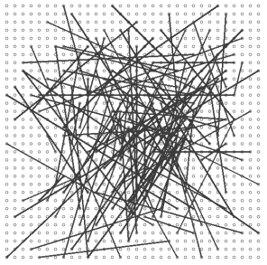


BRIEF descriptors
“Binary Robust Independent Elementary Features”
A set of binary tests in a patch surrounding the interest point
The descriptor is a vector of n binary tests
Details:
n = 256
Patch size: 31x31

Slide 7
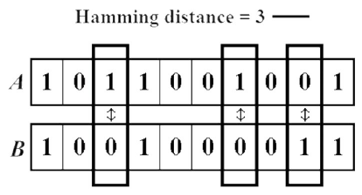
Descriptor Matching
To compare SIFT and SURF descriptor vectors, we used the Euclidean distance between them
This is also called the “L2 norm”
For ORB descriptors we can’t do that
The order of bits is arbitrary
Instead we use the “Hamming distance”
Just count the number of bits that are different

Slide 8
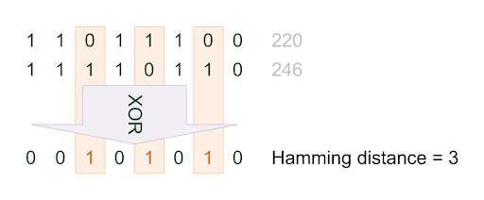
Descriptor Matching
Efficient computation because this is simply an XOR operation between two 256 bit strings
Threshold for matching is the number of bits able to be matched
When using OpenCV’s BFMatcher, select “Hamming” as the distance type:
matcher = cv2.BFMatcher.create(cv2.NORM_HAMMING)

Slide 9
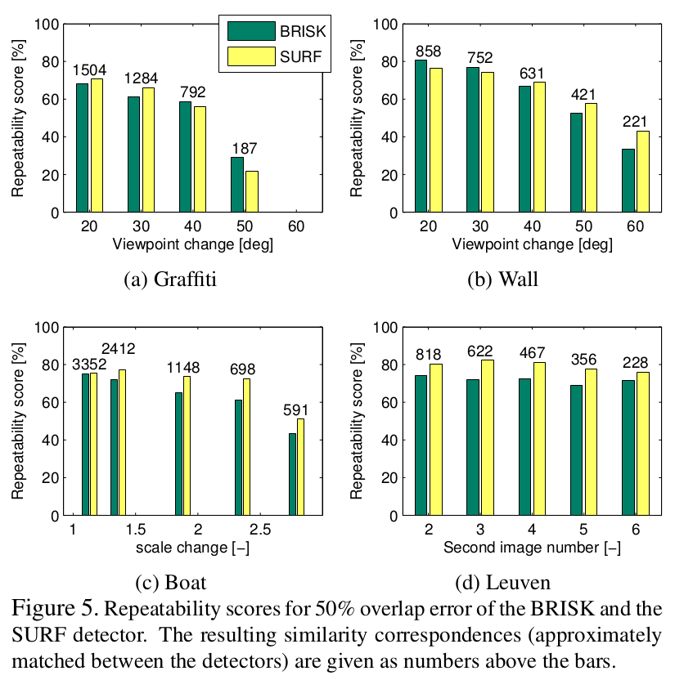
ORB Feature Repeatability
Compares well to SURF when transform is not too large
(BRISK is a variant of BRIEF, just differs in the sampling pattern)
From “Binary Robust Invariant Scalable Keypoints”, Stefan Leutenegger, Margarita Chli and Roland Y. Siegwart, ICCV11

Slide 10
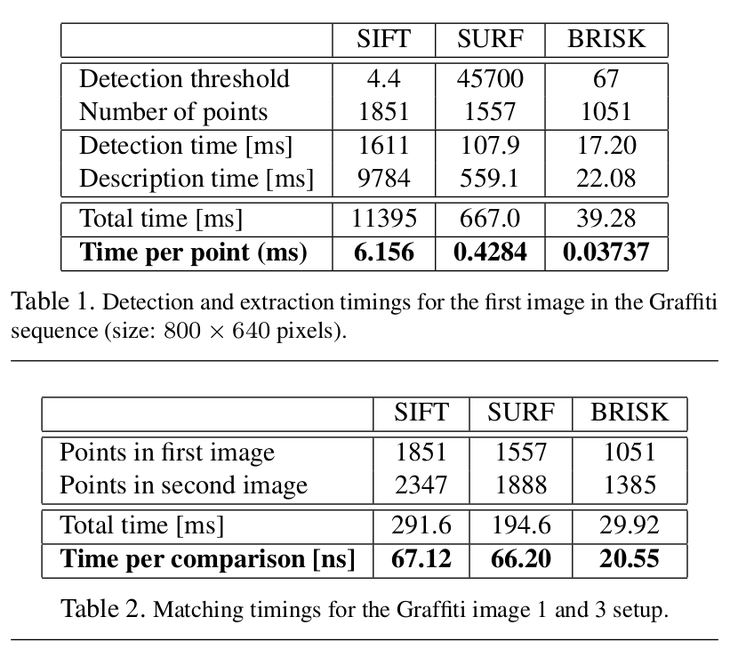
ORB Feature Timing

Slide 11
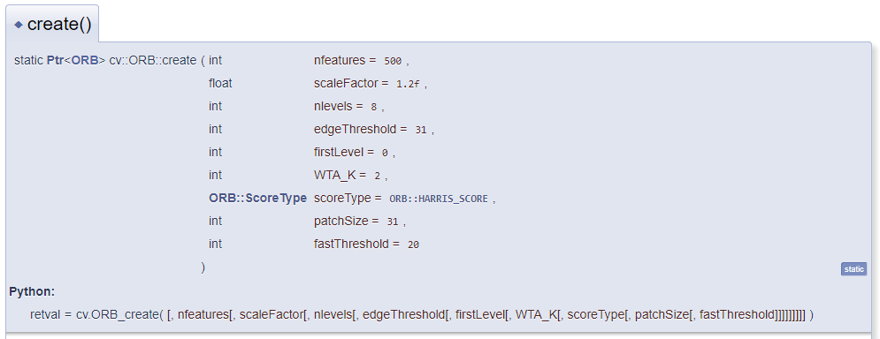
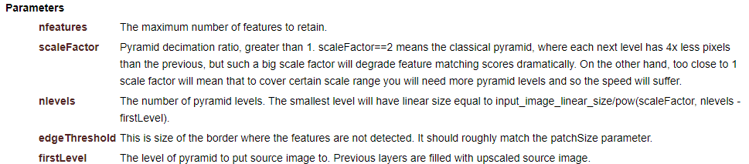
OpenCV
https://opencv.org/

Slide 12
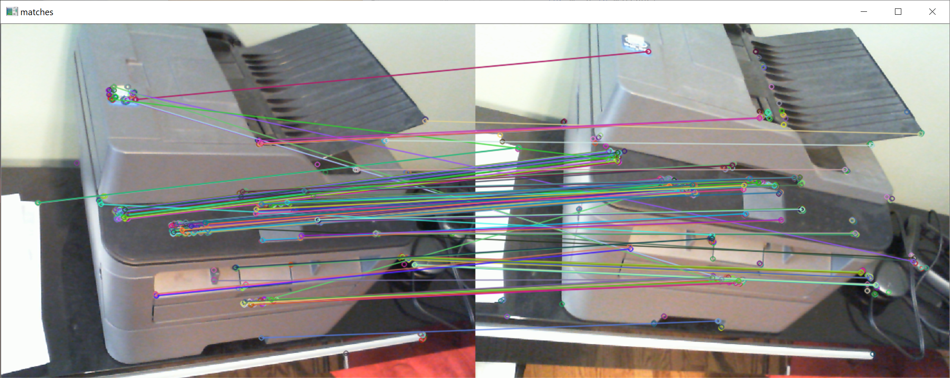
Demo program
Detect and match ORB features from a reference image to a query image

